Slide 1

PREDICTING THE CHANCE OF A PITCH BEING PUT IN PLAY
FITNESS
FITNESS
FITNESS
FITNESS
FITNESS
FITNESS
FITNESS
Analysis and Model Insights

Slide 2

AGENDA
INTRODUCTION
Process and Reasoning
Variables Affecting Batter's Ability
Next Steps
AGENDA
AGENDA

Slide 3

Process and Reasoning
PERSONAL
TRAINING
PERSONAL
TRAINING
PERSONAL
TRAINING
PERSONAL
Process:
Data Preprocessing: Cleaned and transformed the data for modeling.
Feature Selection: Chose relevant features for prediction.
Model Selection: Employed a machine learning algorithm suitable for classification tasks.
Model Training: Trained the model on a labeled dataset.
Model Evaluation: Assessed model performance using appropriate metrics.
Reasoning: Our model leverages past data patterns to predict the likelihood of a pitch being put in play based on these key factors.

Slide 4

INTRODUCTION
INTRODUCTION
INTRODUCTION
We used a machine learning model trained on historical pitch data to make these predictions.
Output: A CSV file with predicted probabilities of each pitch being put in play

Slide 5
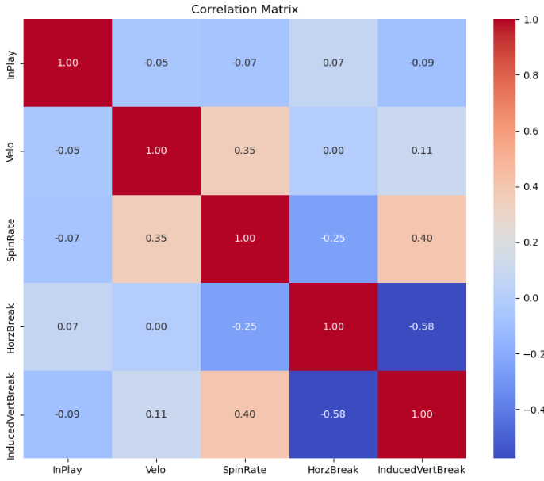
BATTER'S ABILITY
Variables Affecting
Velo (Velocity): Weak negative correlation (-0.052).
SpinRate (Spin Rate): Moderate positive correlation (0.351).
HorzBreak (Horizontal Break): Weak positive correlation (0.073).
InducedVertBreak (Induced Vertical Break): Moderate negative correlation (-0.577).
So, it's like this:
Faster pitches are harder to hit.
Spinning pitches are easier to hit.
Pitches that move sideways are a bit easier to hit.
Pitches that move up or down a lot are harder to hit.

Slide 6

Additional Analysis:
Further explore the impact of individual pitch types on putting the ball in play.
Investigate batter-specific tendencies and performance against certain pitches.
Model Enhancement and Collaboration
Next Steps
Next Steps
Next Steps

Slide 7

THANK YOU
THANK
YOU
THANK
YOU
THANK
YOU
THANK
Hamad Aslam
1hamadaslam@gmail.COM
https://sites.google.com/view/hamad-aslam/

